Slide 1

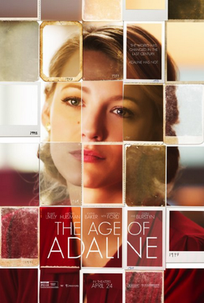

The Age of Adaline
Podcast Presentation
Notes:
1

Slide 2
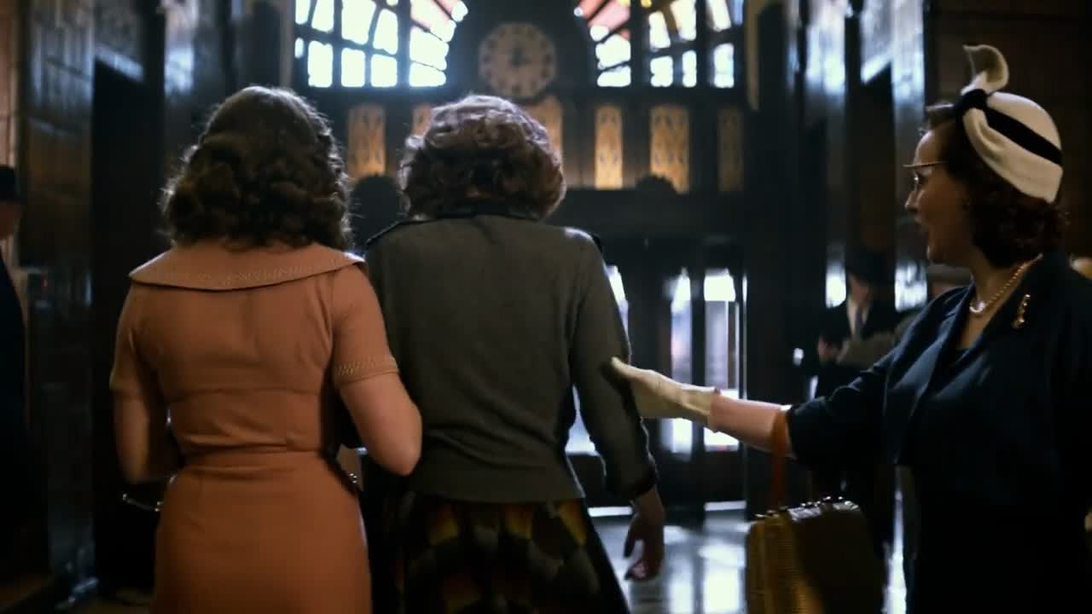
Time and Change

Slide 3
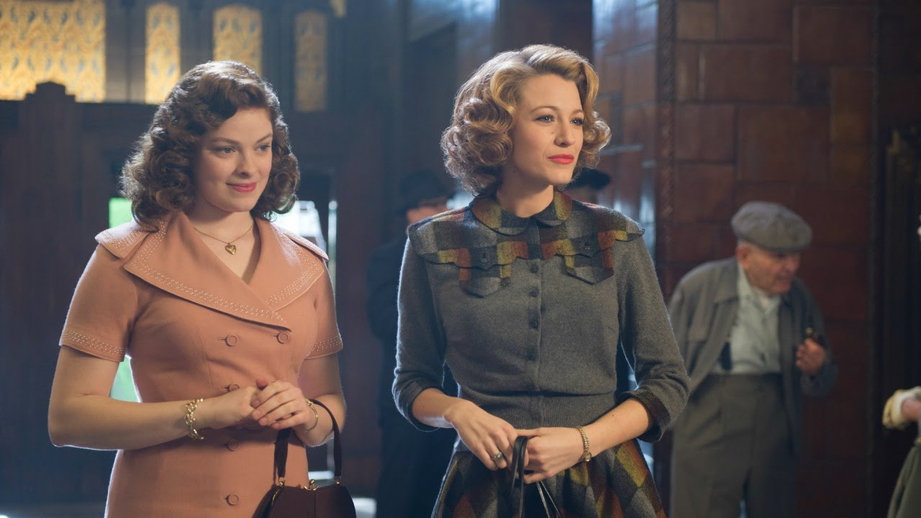
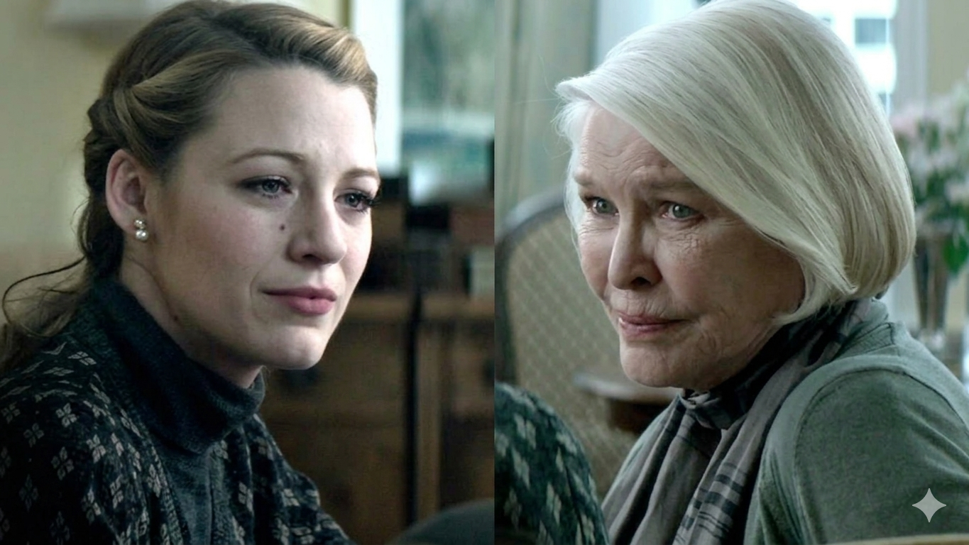
Time and Change
When Adaline's daughter was young
When Adaline's daughter has aged
A visual representation of Adaline's timeless existence alongside the inevitable passage of time in her daughter's life.
Notes:
2

Slide 4
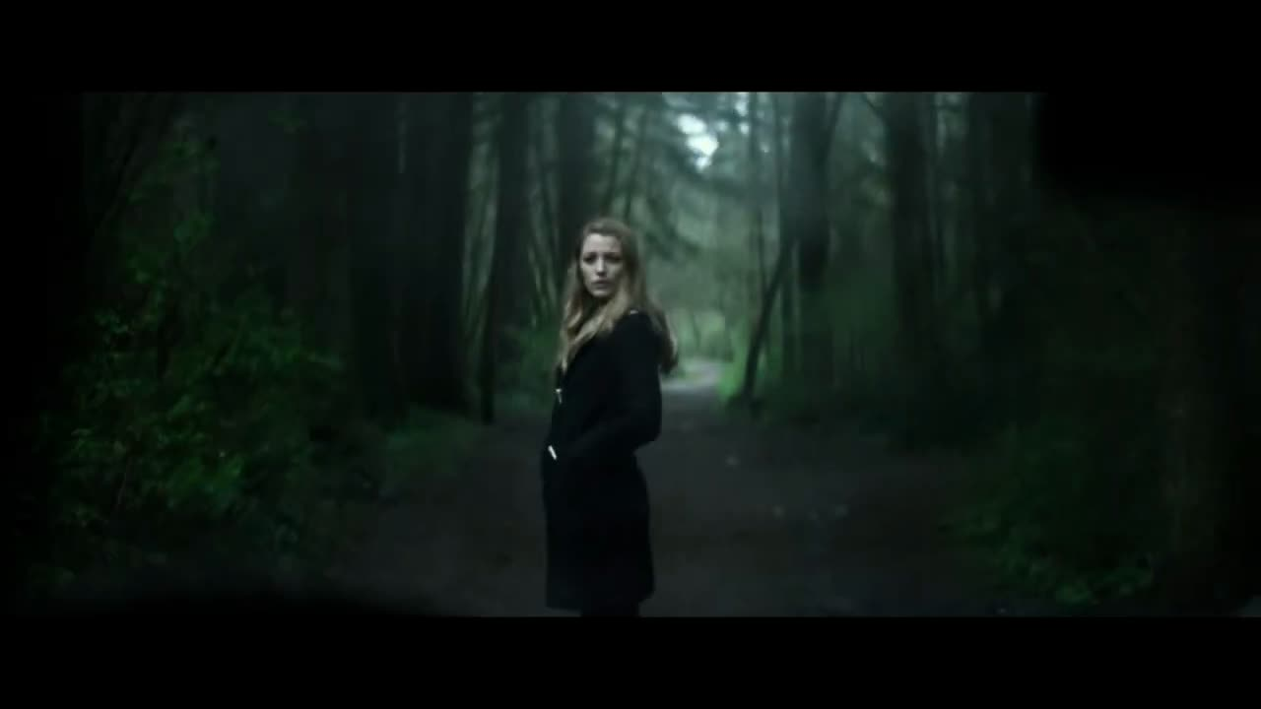
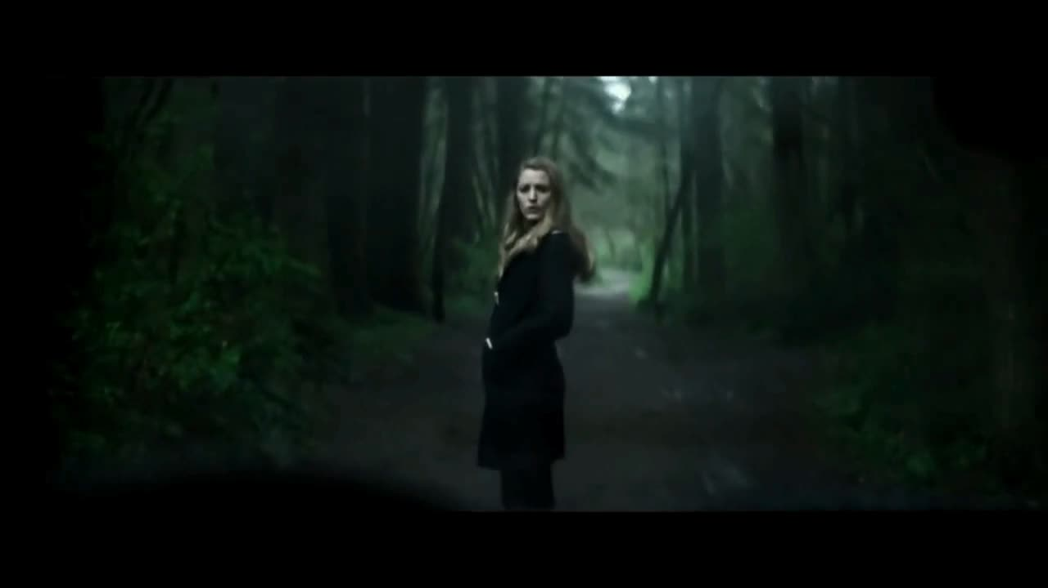
Key Scene
The moment her true identity is discovered
Notes:
3

Slide 5
Thank You for Listening
Any Questions?
Notes:
4

